Slide 1





Site Maps and Navigation
Using ASP.NET Navigation Controls and Site Maps
ASP.NET Web Forms
Telerik Software Academy
http://academy.telerik.com

Slide 2



Table of Contents
Site Navigation and Site Maps
Web.sitemap
Menu, TreeView, SiteMapPath Controls
SiteMapDataSource

Slide 3
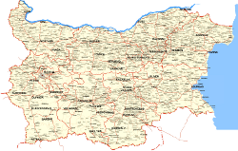

Site Navigation

Slide 4
Site Navigation
Site maps and navigation controls provide an easy way to create navigation in ASP.NET
Site map
Describes the logical structure of a site
Built in support for XML Site Map
Object model
Programming API for accessing the Site Map
SiteMapDataSource
Used for data binding

Slide 5
What is Site Map?
Site Map
A way to describe and store the logical structure of the site
A tree-like data structure
Visual Studio and ASP.NET support Site Maps stored in XML files
To use another storage mechanism you must use a custom SiteMapProvider

Slide 6
XML Site Map
Create an XML file named Web.sitemap in the application root
Automatically detected by the default ASP.NET SiteMapProvider
Add a siteMapNode element for each page in your Web site
Nest siteMapNode elements to create a hierarchy
Should have only one root siteMapNode element

Slide 7
Web.sitemap – Example
<?xml version="1.0" encoding="utf-8" ?>
<siteMap>
<siteMapNode title="Home" description="Home"
url="~/Default.aspx">
<siteMapNode title="Products" description=
"Our products" url="~/Products.aspx" />
<siteMapNode title="Hardware" description=
"Hardware choices" url="~/Hardware.aspx" />
<siteMapNode title="Software" description=
"Software choices" url="~/Software.aspx" />
</siteMapNode>
…
</siteMap>

Slide 8
siteMapNode Attributes
Title – a friendly name of the node (page)
Description – used as a tool tip description in Site Map controls
URL – the URL of the page
Usually starting with "~/" meaning the application root

Slide 9
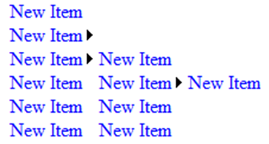
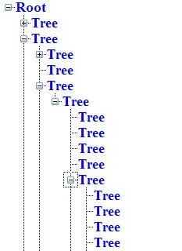

Site Map Controls
Site Map Controls
Menu
TreeView
SiteMapPath

Slide 10
Site Navigation & Controls

Slide 11

Menu Control
The <asp:Menu> is a fully functional menu
Customizable visual styles
Images, effects, direction, …
But it puts inline CSS styles
Two modes
Static – all of the menu is visible
Dynamic – visible only when the mouse pointer is over some of the MenuItem-s

Slide 12
Menu Control (2)
StaticDisplayLevels
The number of statically displayed levels starting from the root
MaximumDynamicDisplay
The number of dynamically displayed levels after the last of the static ones
Element onclick() event
Navigation to another page
Postback to the same page

Slide 13
TreeView Control
TreeView is a control used to display data in a hierarchical view
Supports settings for various images and visual adjustments
Supports navigation and postback
We can create nodes at design time or through code behind
We can fill the nodes on demand (when there is lots of data)
Used together with SiteMapDataSource

Slide 14
SiteMapPath Control
Allows the user to see where he is in the site hierarchy
Displayed in a straightforward fashion
We can set:
PathDirection – RootToCurrent and CurrentToRoot
PathSeparator – a separator between the levels in the hierarchy
ParentLevelsDisplayed – how many parent elements to display

Slide 15
SiteMapDataSource
SiteMapPath has integrated support for Site Map (it reads automatically Web.sitemap)
A SiteMapDataSource object is used to bind the Web.sitemap to a navigation control
First drop one on the page
Set the DataSourceID property of the bound control to point to the SiteMapDataSource
ShowStartingNode – show hide the root

Slide 16
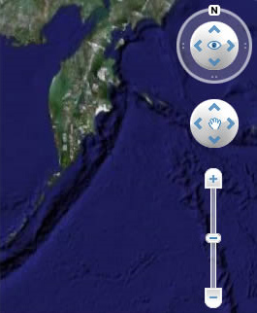

Navigation Controls
Live Demo

Slide 17

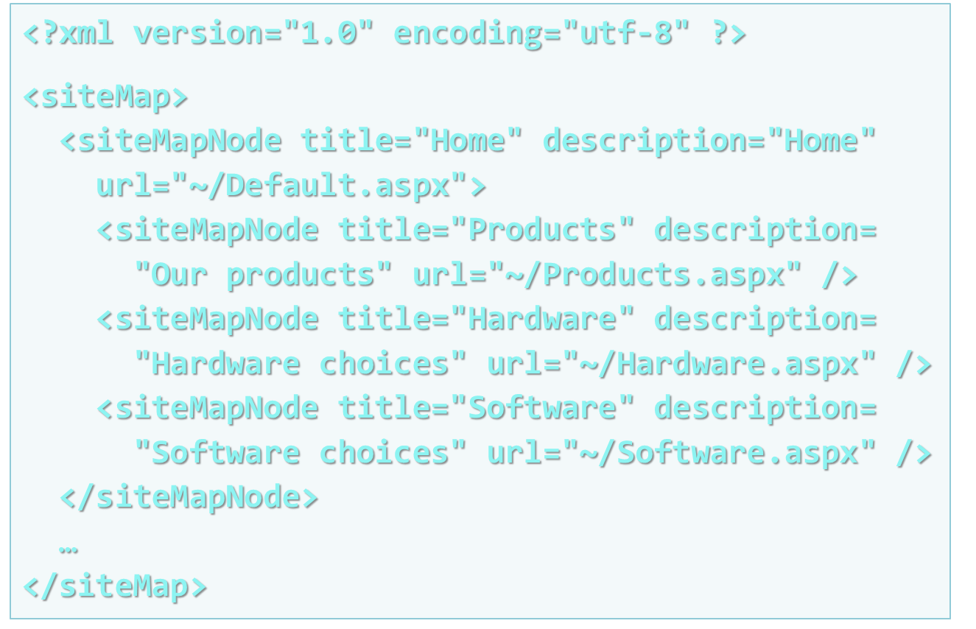
Site Maps and Security
Navigation based on Users and Roles

Slide 18
Navigation and Security
To hide all restricted pages from the navigation menu put the following in Web.config:
To filter menu items based on logged in user / role use the OnMenuItemDataBound event
<siteMap defaultProvider="secureProvider">
<providers>
<add name="secureProvider"
type="System.Web.XmlSiteMapProvider"
siteMapFile="Web.sitemap"
securityTrimmingEnabled="true" />
</providers>
</siteMap>

Slide 19
Filtering the Menu Items
Filtering the menu items loaded from Web.sitemap base on custom logic:
protected void NavigationMenu_MenuItemDataBound(
object sender, MenuEventArgs e)
{
if (ShouldRemoveItem(e.Item.Text))
{
e.Item.Parent.ChildItems.Remove(e.Item);
}
}
private bool ShouldRemoveItem(string menuText)
{
// Custom filtering logic …
}

Slide 20
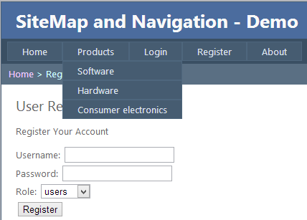
Site Maps and Security
Live Demo

Slide 21

Site Maps and Navigation
?
?
?
?
?
?
?
?
?
http://academy.telerik.com

Slide 22
Exercises
Create a Web application with two-levels of site navigation with the following structure:
Home
Offices
Bulgaria
Sofia, Varna, Plovdiv
U.K.
London, Bristol, Manchester
About
Contacts
Use master pages, menus, breadcrumbs and site map.

Slide 23



Free Trainings @ Telerik Academy
"Web Design with HTML 5, CSS 3 and JavaScript" course @ Telerik Academy
html5course.telerik.com
Telerik Software Academy
academy.telerik.com
Telerik Academy @ Facebook
facebook.com/TelerikAcademy
Telerik Software Academy Forums
forums.academy.telerik.com

